Slide 1
AN INCOME TAX FRAUD DETECTION USING AI & ML
PIP2001 Capstone Project
Review-4
Batch Number:86
Under the Supervision of,
Dr.Jayanthi Kamalasekaran
School of computer science and engineering
jayanthi.k@presidencyuniversity.in
8446075868
Presidency university
Roll Number | Student Name
20211CSE0135 | D SOYA SREE
20211CSE0101 | P S AFREEN
20211CSE0013 | P SRUTHI
20211CSE0478 | B PRANAVI
Name of the Program: CSE
Name of the HoD: Dr.Asif Mohammed H.B
Name of the Program Project Coordinator: Mr. Amarnath J.L & Dr. Jayanthi. K.
Name of the School Project Coordinators: Dr. Sampath A K / Dr. Abdul Khadar A / Mr. Md Ziaur Rahman

Slide 2
Introduction
Financial fraud is a pervasive issue in the global financial industry, leading to substantial financial losses and undermining the trust and stability of financial institutions. As the volume and complexity of financial transactions continue to grow, so does the sophistication of fraudulent activities. Traditional fraud detection methods, often based on manual processes and rule-based systems, are increasingly inadequate in addressing the dynamic and evolving nature of fraud. This project aims to develop an advanced fraud detection framework using machine learning algorithms to classify financial transactions accurately into "Fraudulent" and "Non-fraudulent" categories. By leveraging data warehousing, data visualization, information retrieval, and stream processing analytics, the project seeks to enhance the precision and efficiency of fraud detection systems. The proposed framework incorporates a comprehensive data warehousing solution to handle and store vast amounts of transactional data, facilitating efficient data retrieval and thorough analysis. Advanced data structures and information retrieval methods are employed to improve the accuracy and speed of fraud detection algorithms. Machine learning models, including Decision Tree, Logistic Regression, Random Forest, and Naïve Bayes, are developed and optimized to identify patterns and anomalies indicative of fraudulent activities.

Slide 3
Literature Review
Discuss existing research in tax fraud detection and AI applications in finance.
Mention notable techniques such as anomaly detection, decision trees, and neural networks used in fraud detection.
Highlight the gap in existing solutions, such as limited datasets or challenges with real-time fraud detection, and how your project addresses these limitations.

Slide 4
Existing method Drawback
Most traditional tax fraud detection methods rely on manual audits or basic rule-based systems. These are time-consuming, prone to human error, and unable to scale with large data volumes.
The inefficiency in flagging high-risk cases early is another drawback that justifies the need for AI and ML approaches.

Slide 5
Proposed Method
The proposed system leverages machine learning algorithms and advanced data processing techniques to create a robust and adaptive fraud detection framework. This system classifies transactions into "Fraudulent" and "Non-fraudulent" categories using models like Decision Tree, Logistic Regression, Random Forest, Naïve Bayes, and K-Means Clustering.

Slide 6
Objectives
Build a model to predict potential tax fraud with high accuracy and minimal false positives.
Reduce the workload for tax authorities by automating the detection process.
Ensure real-time analysis so that fraudulent claims can be flagged as early as possible.
Make the model scalable and capable of handling large datasets with diverse features.

Slide 7
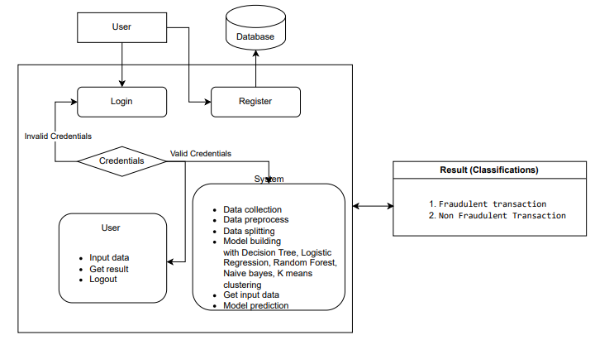
Architecture

Slide 8
Hardware/software components
Hardware: Basic computing resources, possibly cloud-based for handling large datasets.
Software: Python with libraries like TensorFlow, Scikit-learn, and Pandas for data manipulation and model building.
Frameworks: Jupyter Notebooks for experimentation and GitHub for version control.

Slide 9
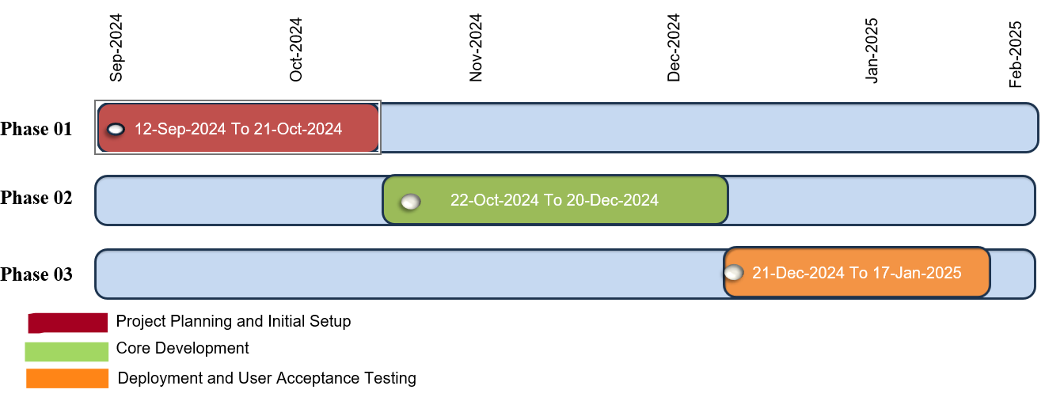
Timeline of Project

Slide 10
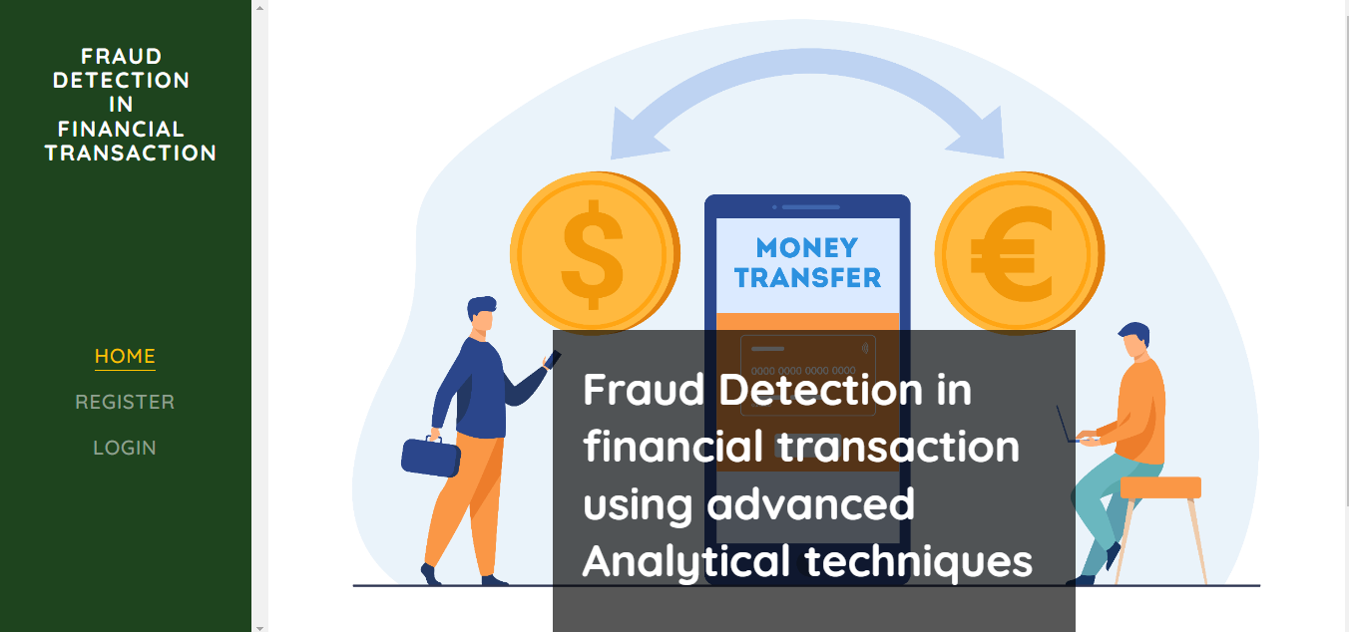
Outcomes
Home Page: The Home page serves as the landing page of your application. It provides an overview of the project's features, objectives, and benefits. Users can navigate to other sections of the application from this page.

Slide 11
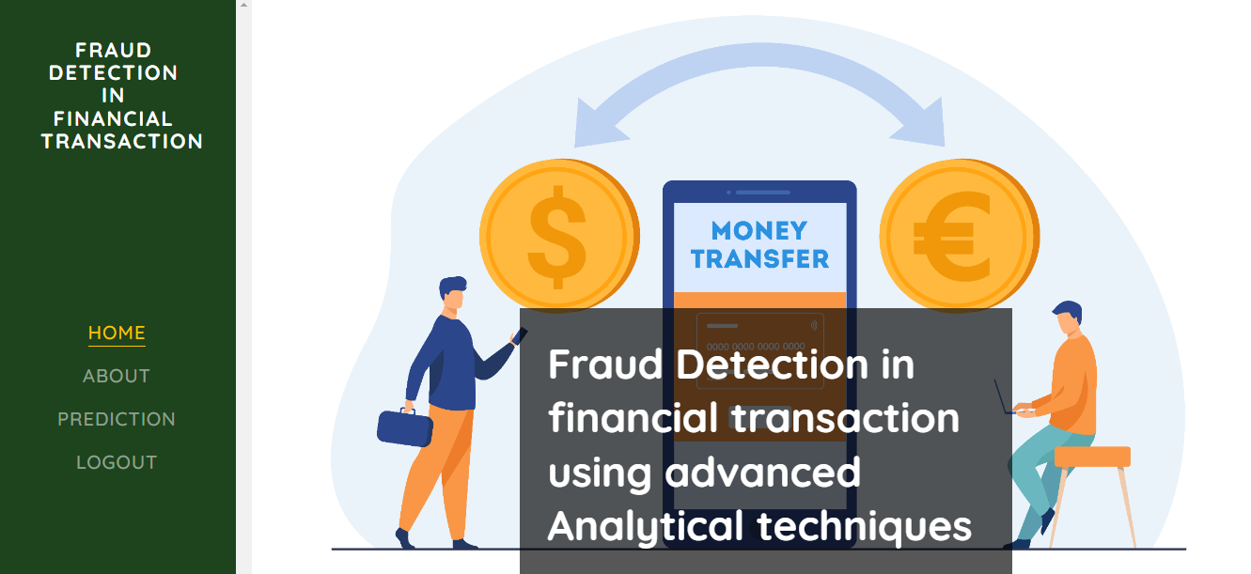
Registration Page : The Registration Page allows new users to create an account with the application. It typically includes fields for entering personal information such as name, email, password, and possibly other details like phone number or address. Users need to fill out this form to gain access to the application's features.

Slide 12
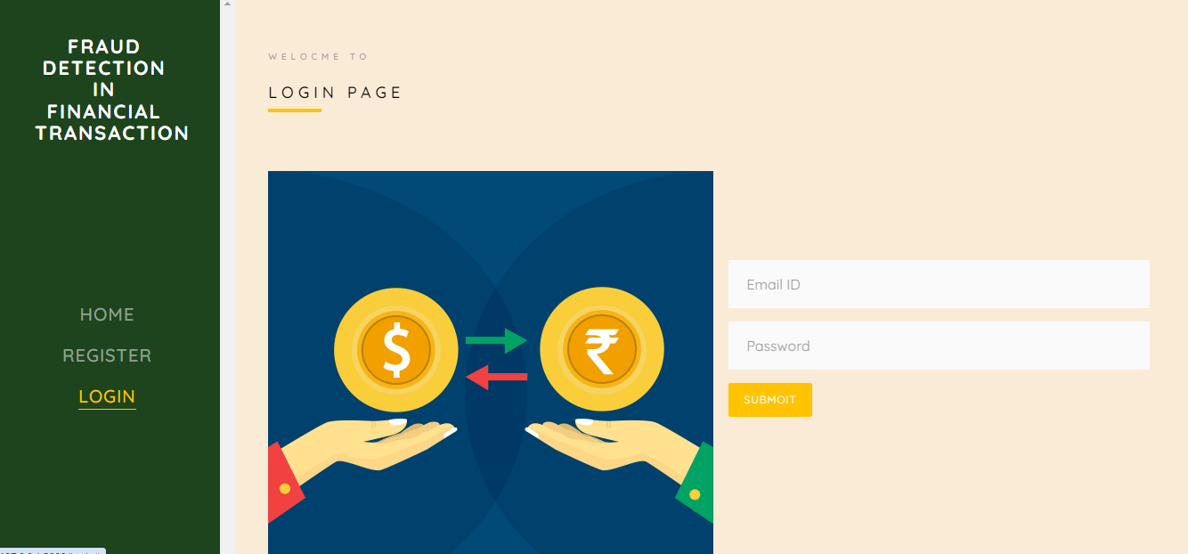
Login Page: The Login Page enables users to access their existing accounts by entering their credentials.
It usually includes fields for entering a username/email and password.

Slide 13
User home Page : After user successfully login this page will be appear.

Slide 14
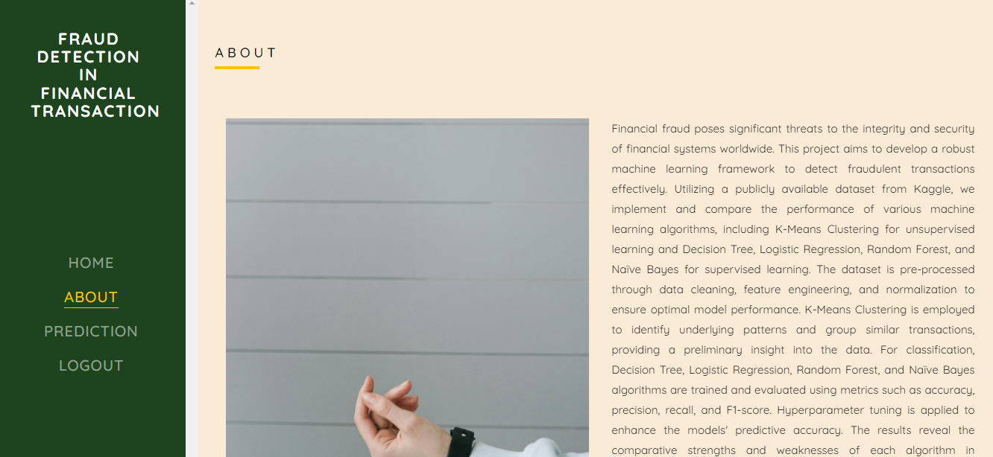
About Page : The About Page offers detailed information about the project, including its purpose, goals, and
the technology used. It provides background information on the problem being addressed and the methods employed.

Slide 15
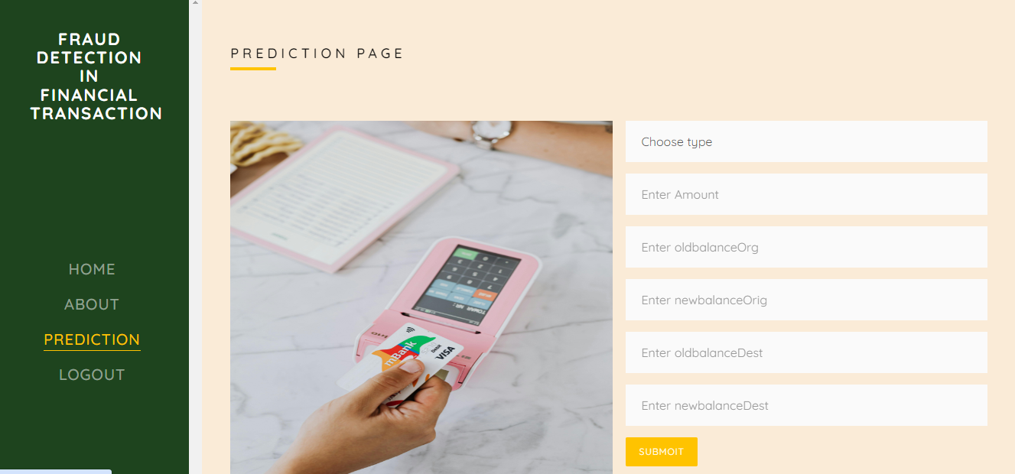
Prediction Page: The Prediction Page allows users to input data and receive predictions based on the trained machine learning models. This page typically includes a form or interface for uploading or entering data

Slide 16
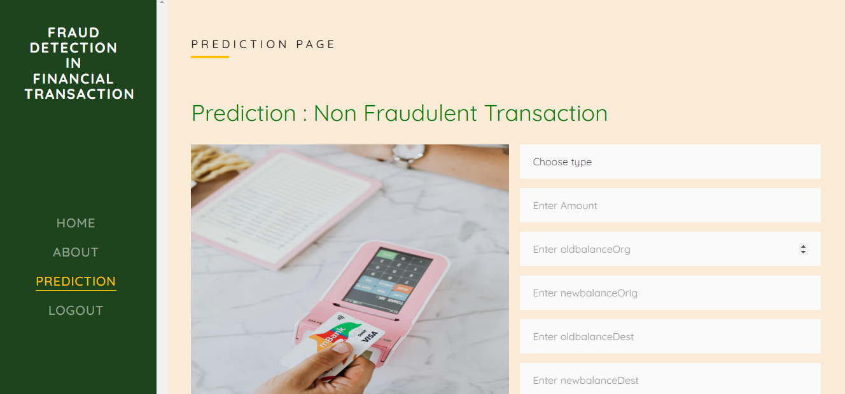
Result Page: In here result will be display which is predicted by our trained model

Slide 17
Conclusion
This project successfully developed an advanced fraud detection framework using machine learning algorithms to classify financial transactions into "Fraudulent" and "Non-fraudulent" categories. By leveraging Decision Tree, Logistic Regression, Random Forest, Naïve Bayes, and K-Means Clustering, the system demonstrated enhanced detection accuracy, adaptability, and scalability. The integration of comprehensive data preprocessing techniques, real-time processing capabilities, and robust evaluation metrics ensured the system's reliability and effectiveness. The project addressed the limitations of traditional rule-based systems by providing a proactive and automated approach to fraud detection, significantly reducing false positives and improving operational efficiency. The findings highlight the potential of combining multiple advanced analytical techniques to enhance the security and trust in financial systems, offering a significant improvement in combating financial fraud. Future work will focus on further optimizing the models, exploring additional machine learning techniques, and enhancing the practical implementation of the system in real-world financial environments.

Slide 18
Github Link
The Github link provided should have public access permission.
Github Link
https://github.com/Soyadasari/an-income-tax-fraud-detection-using-ai-and-ml

Slide 19
References
https://www.researchgate.net/publication/367405432_A_Multi-Module_Machine_Learning_Approach_to_Detect_Tax_Fraud
https://www.researchgate.net/publication/372447195_JOURNAL_OF_CRITICAL_REVIEWS_AN_INCOME_TAX_FRAUD_DETECTION_USING_AI
https://ieeexplore.ieee.org/document/10601922

Slide 20

Project work mapping with SDG

Slide 21
Thank You

